Slide 1
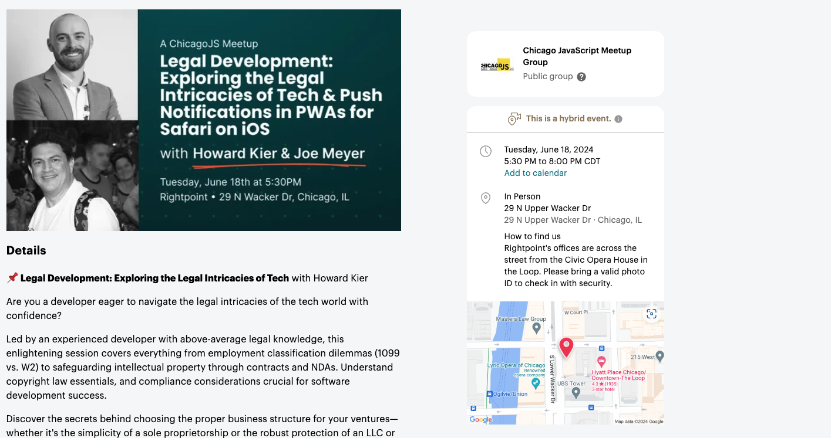

Slide 2
Push Notifications in PWAs for iOS Safari

Slide 3


About Me
Rightpoint ~10
Software Development ~15 years
React, React Native, PWAs
Safari User

Slide 4
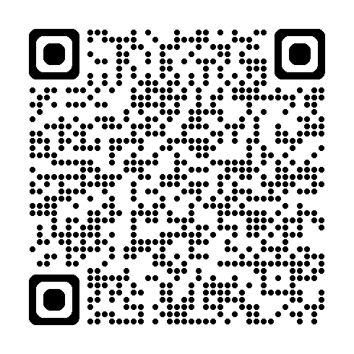
About PWAs (Progressive Web Apps)
Combine the best features of traditional websites with platform-specific apps
Developed using standard web tech
Accessible directly from the web
Can leverage “app” features
Installable – web or store (Google, Microsoft, Meta)
Full screen, app icon, etc
Background content updates
Offline mode
Push Notifications
Notes:
Store install: https://developer.mozilla.org/en-US/docs/Web/Progressive_web_apps/Guides/Making_PWAs_installable#installation_from_an_app_store

Slide 5
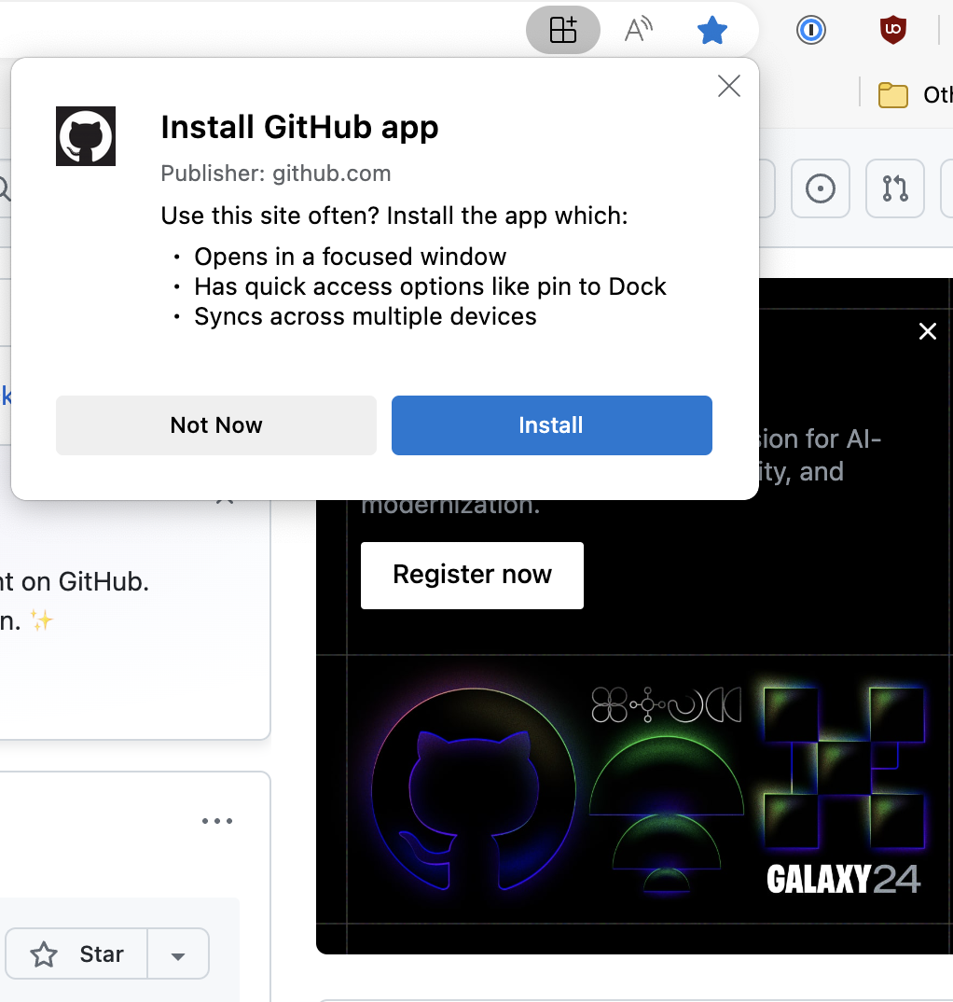
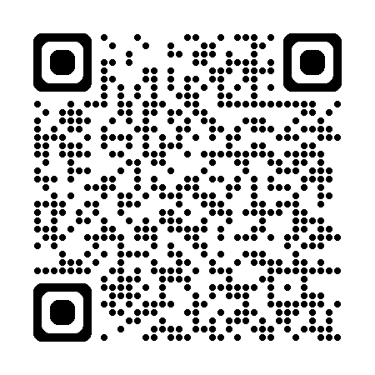
About Service Workers
Enables most “PWA” features
Download/Install/Activate Lifecycle
For this demo, we’ll be using Serwist to bootstrap our Service Worker code & configuration
Notes:
Serwist support next and vite, but you can configure the worker manually

Slide 6
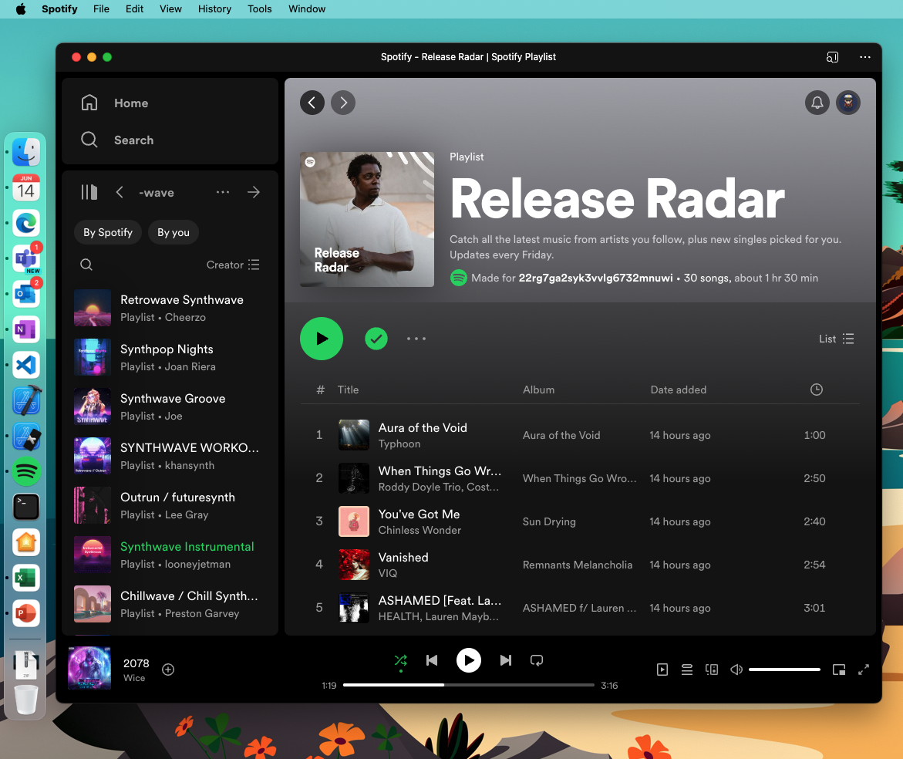
“Famous” PWAs
https://github.com/
https://open.spotify.com/
https://developer.mozilla.org/

Slide 7
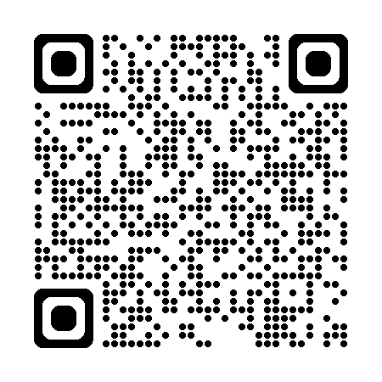
Caveats for PWAs
Checkered browser support for various web worker APIs
Checkered browser version support (i.e – Safari >= 16.4)
Brief-ish drama regarding PWAs after EU passes Digital Markets Act (DMA)
Varying supported config per browser (Required icons, properties, etc.)
Varying execution methods per browser (Install process, etc.)
Higher barrier to install/adoption than either web or native apps
Notes:
Browser support: https://caniuse.com/?search=service%20worker
DMA + iOS: https://techcrunch.com/2024/03/01/apple-reverses-decision-about-blocking-web-apps-on-iphones-in-the-eu/

Slide 8
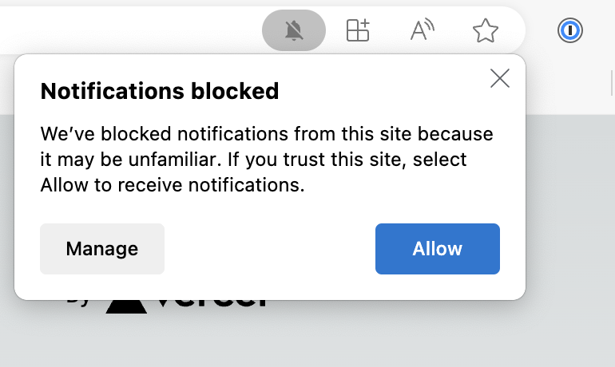
Tips, Tricks, and Pitfalls
Develop on desktop Chrome/Edge/Firefox – test on Safari desktop, then mobile
Test on multiple browsers and devices
Run your PWA on an unusual port or unregister it when complete to prevent Service Worker caching
Your browser may block notifications if the URL is “suspicious” (Vercel)

Slide 9
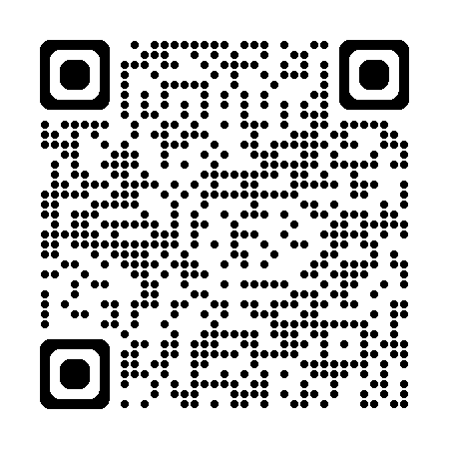
Demo App
https://serviceworker-safari-sage.vercel.app/

Slide 10
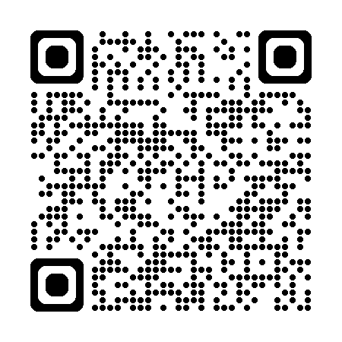
Demo Code
https://github.com/JoeM-RP/serviceworker-safari

Slide 11
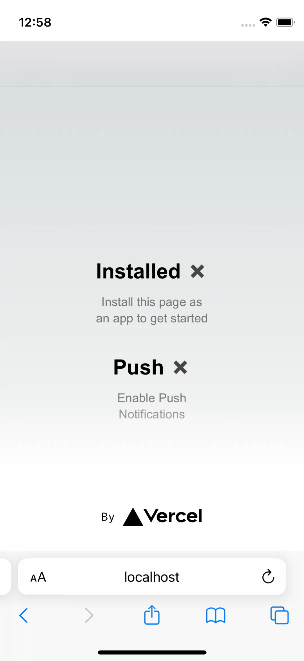
About the Demo
Blank app created with ”create next app”
Serwist for worker config
Deployed via Vercel
Notes:
Serwist support next and vite, but you can configure the worker manually

Slide 12
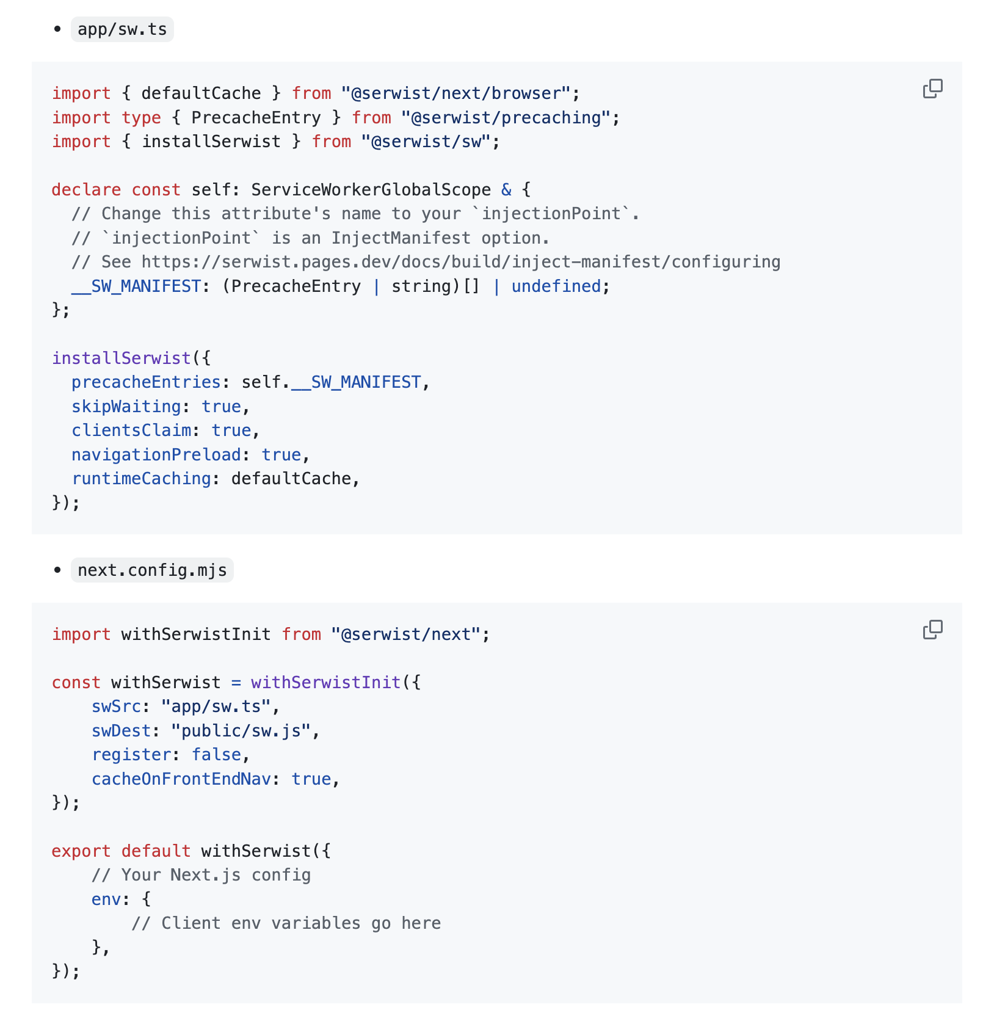
Serwist Setup
We’ll register the worker manually

Slide 13
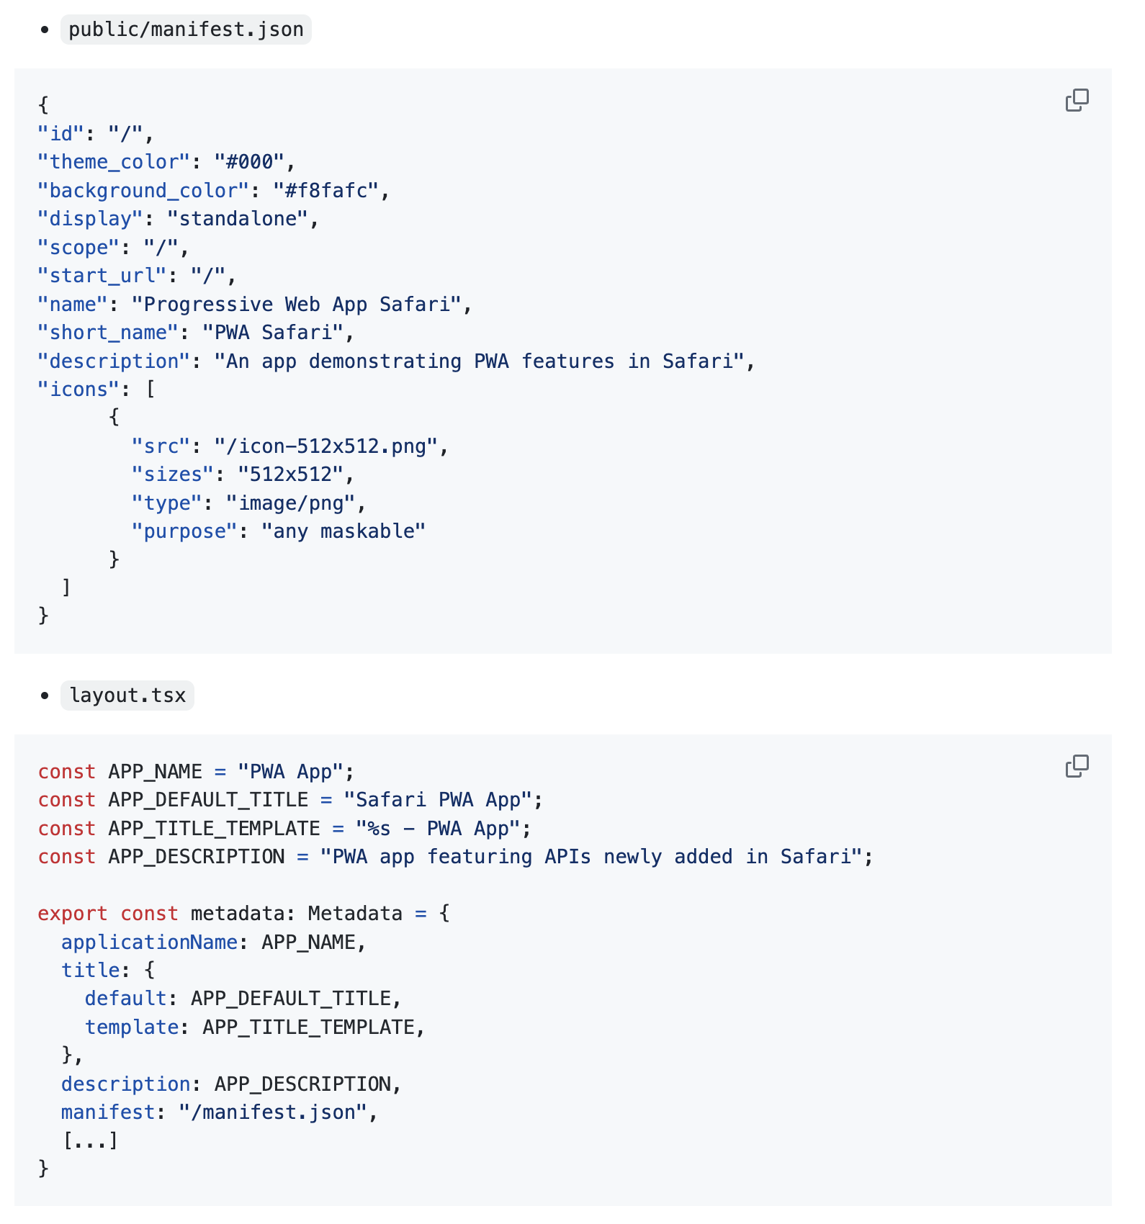
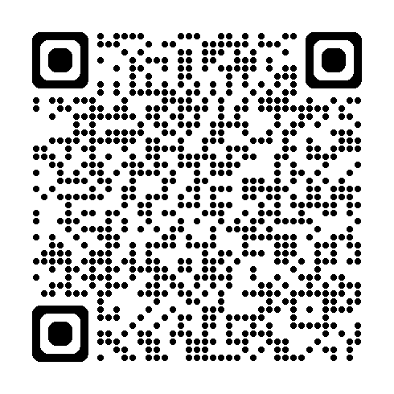
Manifest Setup see “Making PWAs Installable”
Must provide at least 1 icon

Slide 14
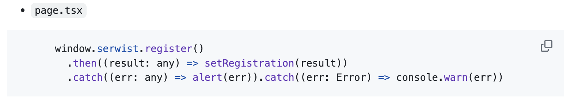
Worker Registration
Add worker registration to app state

Slide 15
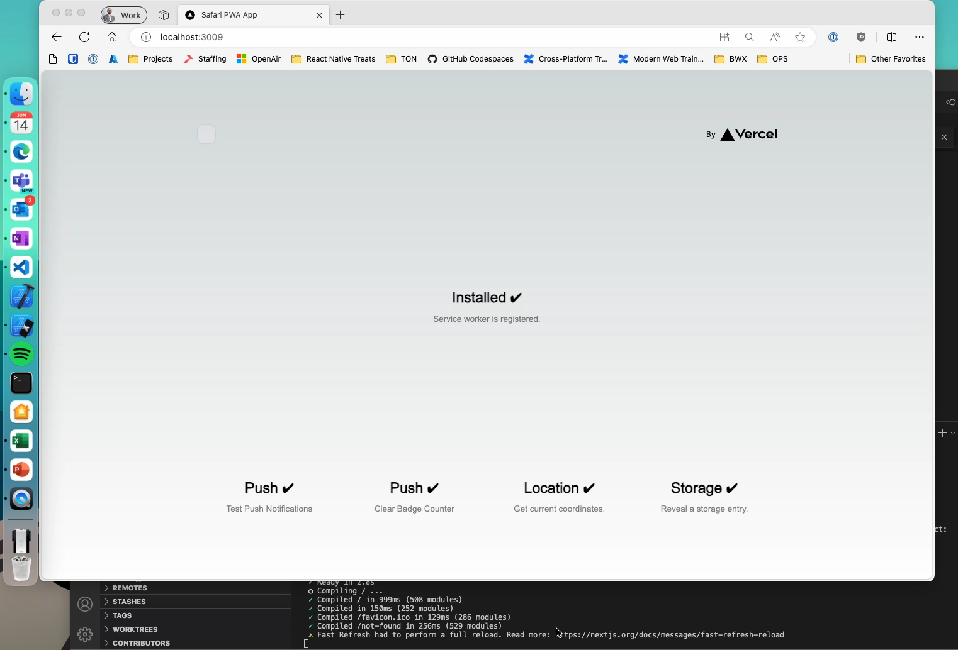

Slide 16
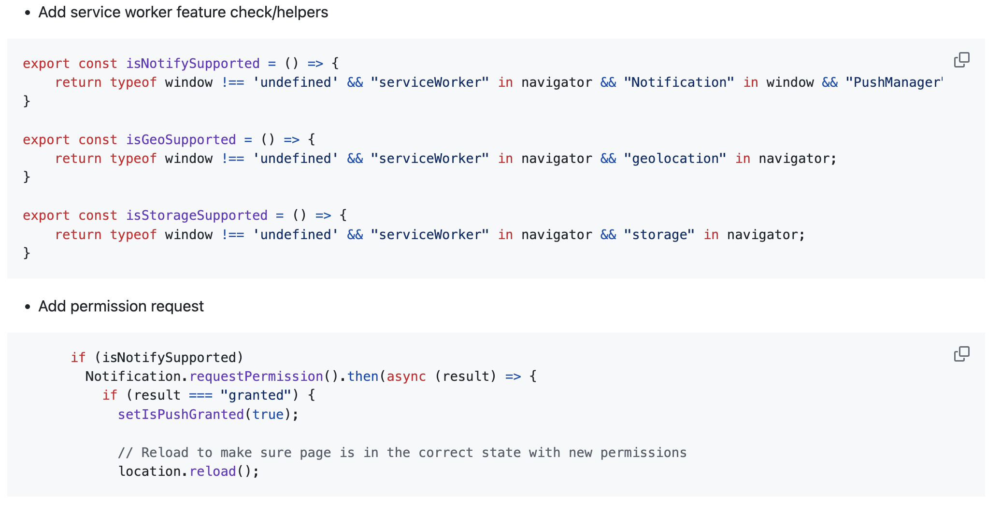
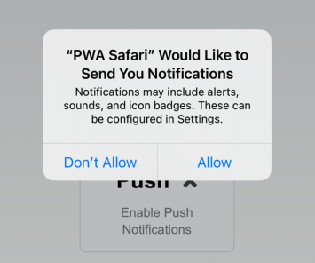
Permission Request

Slide 17
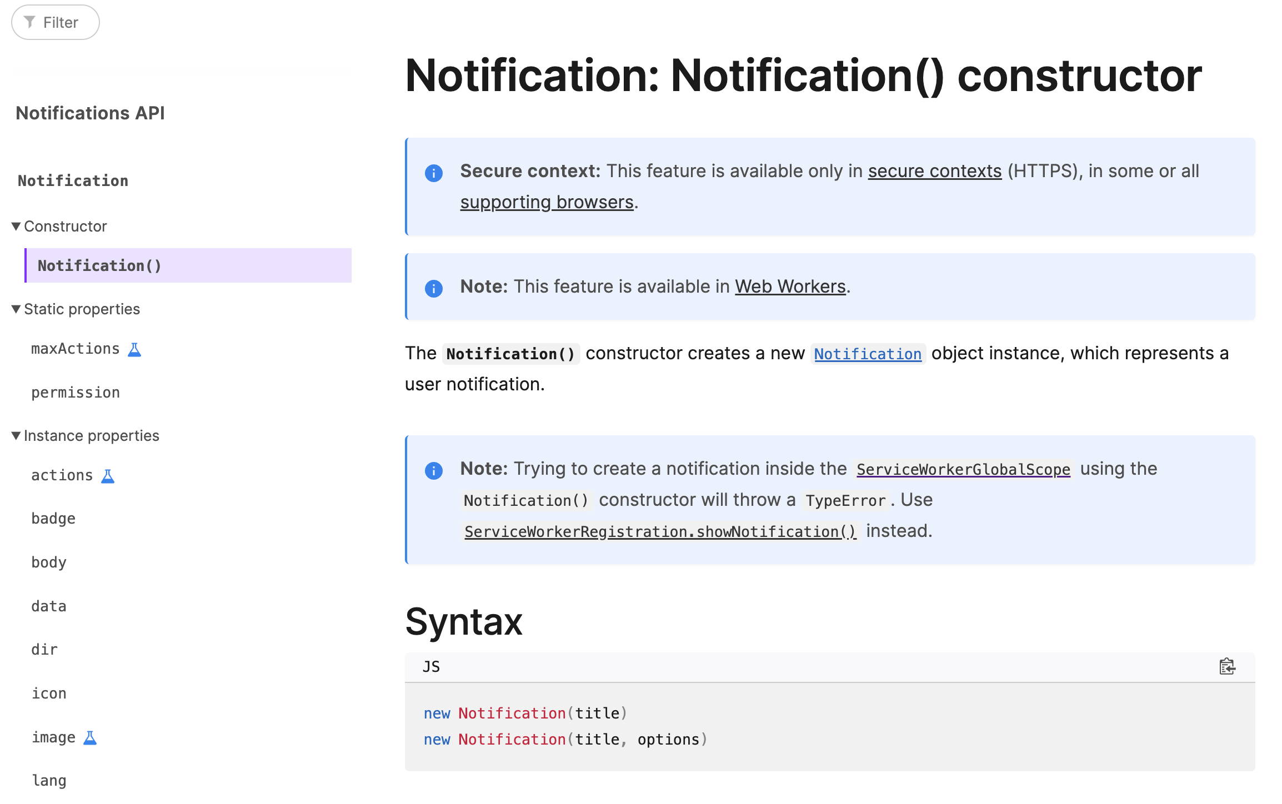

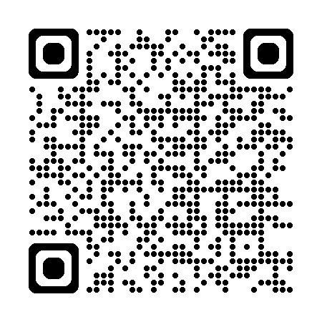
Build a push notification!

Slide 18
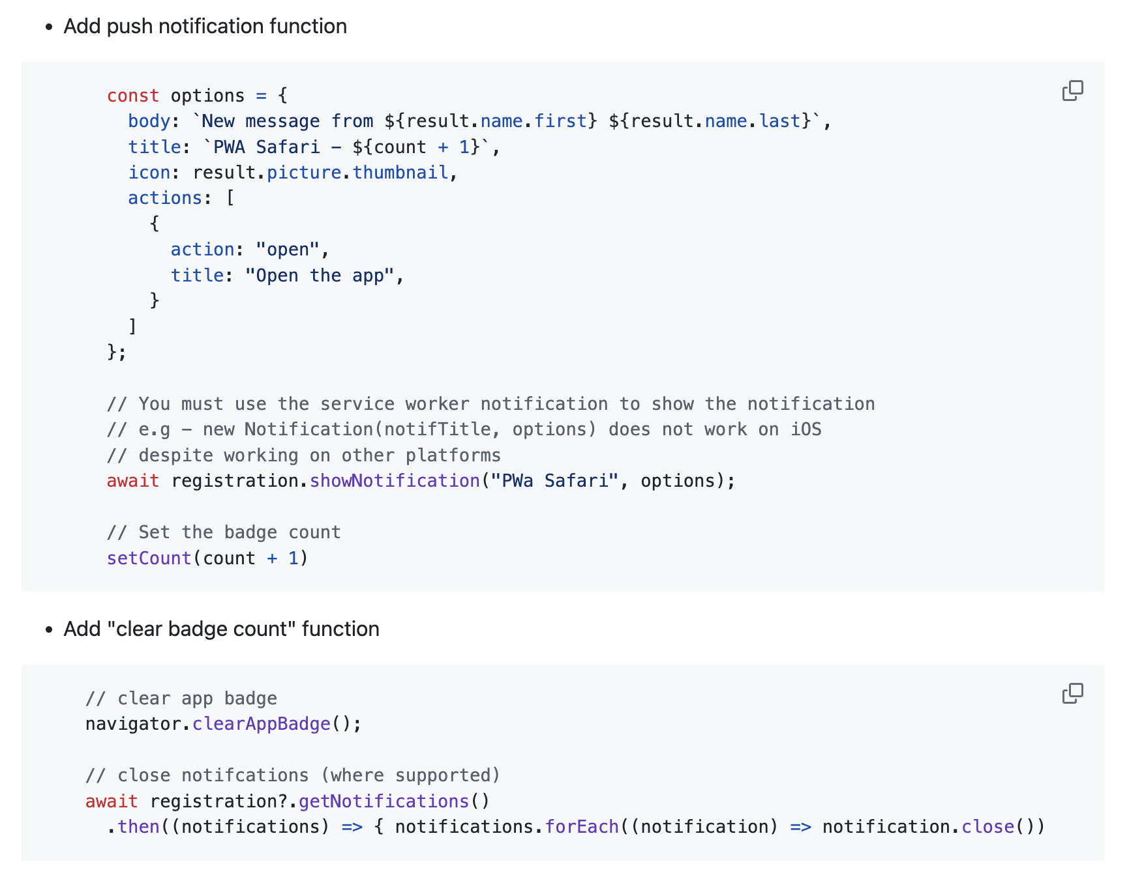
Build a push notification! (for real)

Slide 19
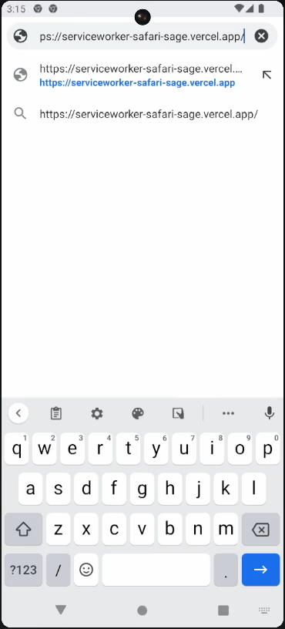
Finished Product
Notes:
Serwist support next and vite, but you can configure the worker manually

Slide 20
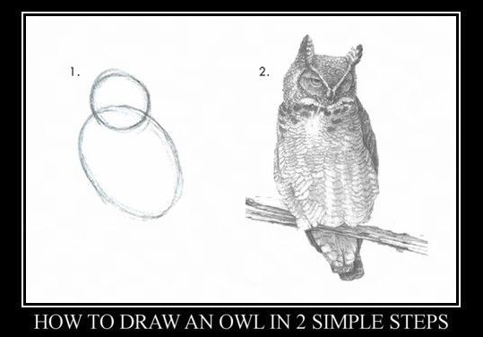
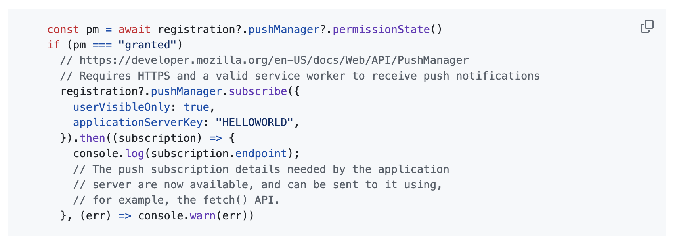
Remote Push Notifications
Notes:
https://developer.mozilla.org/en-US/docs/Web/API/PushManager/subscribe https://developer.mozilla.org/en-US/docs/Web/API/PushSubscription
applicationServerKey: Is a Base64-encoded string or ArrayBuffer containing an ECDSA P-256 public key that the push server will use to authenticate your application server. If specified, all messages from your application server must use the VAPID authentication scheme, and include a JWT signed with the corresponding private key. This key IS NOT the same ECDH key that you use to encrypt the data. For more information, see "Using VAPID with WebPush".
Returns PushSubscription.endpoint Read only A string containing the endpoint associated with the push subscription.
PushSubscription.expirationTime Read only A DOMHighResTimeStamp of the subscription expiration time associated with the push subscription, if there is one, or null otherwise.
PushSubscription.options Read only An object containing the options used to create the subscription.
PushSubscription.subscriptionId Deprecated Read only Non-standard A string containing the subscription ID associated with the push subscription.

Slide 21
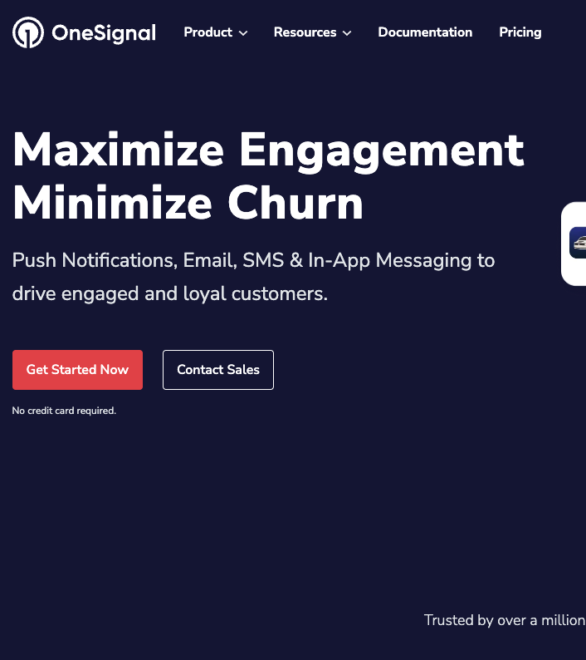
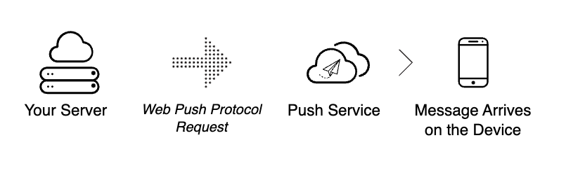
Sending a Push Notification
Client app gets permission to subscribe
Client sends registration info to Push Service or server using auth key
Push Service/Server logs registration info
Server sends message info, client(s)/recipient(s), and delivery info to push service for delivery to end-user
Notes:
https://web.dev/articles/push-notifications-overview
After you get permission, your website needs to initiate the process of subscribing the user to push notifications. This is done through JavaScript, using the Push API. You'll need to provide a public authentication key during the subscription process, which you'll learn more about later. After you kick off the subscription process, the browser makes a network request to a web service known as a push service, which you'll also learn more about later.
Assuming that the subscription was successful, the browser returns a PushSubscription object. You'll need to store this data long-term. Usually this is done by sending the information to a server that you control, and then having the server store it in a database.
Your server doesn't actually send the push message directly to a client. A push service does that. A push service is a web service controlled by your user's browser vendor. When you want to send a push notification to a client you need to make a web service request to a push service. The web service request that you send to the push service is known as a web push protocol request. The web push protocol request should include:
What data to include in the message.
What client to send the message to.
Instructions on how the push service should deliver the message. For example, you can specify that the push service should stop attempting to send the message after 10 minutes.
Normally you make the web push protocol request through a server that you control. Of course, your server doesn't have to construct the raw web service request itself. There are libraries that can handle that for you, such as the web-push-libs. But the underlying mechanism is a web service request over HTTP.
Example Push Services
OneSignal
Amazon Simple Notification Service SNS
Airship

